Slide 1
Lectuer-15 Database Design and Applications
Ashish Narang

Slide 2
First Semester
2020-21

Slide 3
Contents
Distributed Databases
Architecture of Distributed Databases
Data Fragmentation, Replication and Allocation
Query Processing in Distributed Databases
Distributed Query Processing using semi-join
Two Phase commit Protocol

Slide 4
Distributed Databases
We define a distributed database as a collection of multiple, logically interrelated databases distributed over a computer network .
A distributed database management system (distributed DBMS) is then defined as the software system that permits the management of the distributed database and makes the distribution transparent to the users .

Slide 5
Contd..
For a database to be called distributed database the following conditions should be satisfied.
Connection of database nodes over a computer network
Logical interrelation of connected databases
Absence of homogeneity constraint among connected nodes

Slide 6
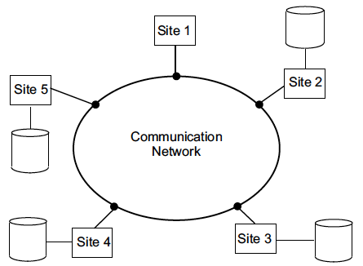
Contd..

Slide 7
Promises of Distributed Databases
Transparent Management of Distributed and Replicated Data
Data Distribution
Replication Transparency
Fragmentation Transparency
Autonomy
Reliability and availability

Slide 8
Data Distribution Transparency
This refers to freedom for the user from the operational details of the network and the placement of the data in the distributed system. It may be divided into
Location transparency
Naming transparency

Slide 9
Replication Transparency
Copies of the same data objects may be stored at multiple sites for better availability, performance, and reliability.
Replication transparency makes the user unaware of the existence of these copies.

Slide 10
Fragmentation Transparency
Two types of fragmentation are possible.
Horizontal fragmentation distributes a relation (table) into sub relations that are subsets of the tuples (rows) in the original relation.
Vertical fragmentation distributes a relation into sub relations where each sub relation is defined by a subset of the columns of the original relation.
A global query by the user must be transformed into several fragment queries.
Fragmentation transparency makes the user unaware of the existence of fragments.

Slide 11
Autonomy
Autonomy determines the extent to which individual nodes or DBs in a connected DDB can operate independently.
A high degree of autonomy is desirable for increased flexibility and customized maintenance of an individual node.

Slide 12
Reliability and Availability
Reliability is broadly defined as the probability that a system is running (not down) at a certain time point.
Availability is the probability that the system is continuously available during a time interval.

Slide 13
Advantages of Distributed Databases
Improved ease and flexibility of application development
Increased reliability and availability
Improved performance.
Easier expansion.

Slide 14
Complicating Factors
Keeping track of data distribution
Distributed query processing
Distributed transaction management
Replicated data management
Distributed database recovery
Security
Distributed directory (catalog) management.

Slide 15
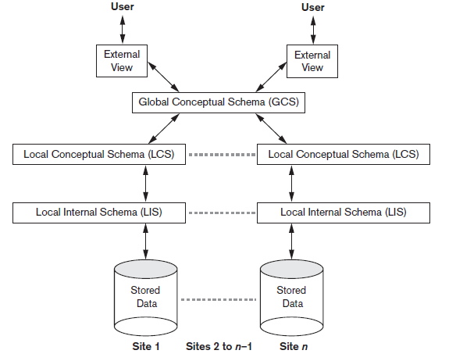
Schema Architecture of Distributed Database

Slide 16
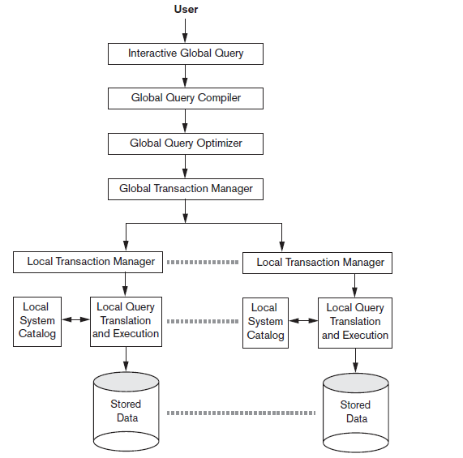
Component Architecture of Distributed Databases

Slide 17
Data Fragmentation, Replication and Allocation
Database is divided into logical units called fragments which may be assigned for storage at various sites.
Data replication permit certain data to be stored at more than one site.
Data is allocated to different sites based on certain factors

Slide 18
Data Fragmentation
Horizontal fragmentation divides a relation horizontally by grouping rows to create subsets of tuples, where each subset has a certain logical meaning. These fragments can then be assigned to different sites in the distributed system.
Vertical fragmentation divides a relation “vertically” by columns. A vertical fragment of a relation keeps only certain attributes of the relation.
It is necessary to include the primary key or some candidate key attribute in every vertical fragment so that the full relation can be reconstructed from the fragments
We can intermix the two types of fragments yielding a mix fragment.

Slide 19
Data Replication and Allocation
Fully replicated distributed database: replicating whole database at every site.
No replication: Each fragment is exactly stored at one site. In this case fragments must be disjoint.
Partial replication: some fragments of database may be replicated while others may not.
For data distribution, choice of sites and degree of replication depends on the performance and availability goals of the system.

Slide 20
Example
Suppose that the company has three computer sites—one for each current department.
Sites 2 and 3 are for departments 5 and 4, respectively. At each of these sites, we expect frequent access to the EMPLOYEE and PROJECT information for the employees who work in that department and the projects controlled by that department.
Further, we assume that these sites mainly access the Name, Ssn, Salary, and Super_ssn attributes of EMPLOYEE.
Site 1 is used by company headquarters and accesses all employee and project information regularly, in addition to keeping track of DEPENDENT information for insurance purposes.

Slide 21
Contd..
According to these requirements, the whole database can be stored at site 1.
To determine the fragments to be replicated at sites 2 and 3, first we can horizontally fragment DEPARTMENT by its key Dnumber. Then we apply derived fragmentation to the EMPLOYEE, PROJECT, and DEPT_LOCATIONS relations based on their foreign keys for department number—called Dno, Dnum, and Dnumber respectively.
We can vertically fragment the resulting EMPLOYEE fragments to include only the attributes {Name, Ssn, Salary, Super_ssn, Dno}.

Slide 22
Contd..
We must now fragment the WORKS_ON relation and decide which fragments of WORKS_ON to store at sites 2 and 3.
We are confronted with the problem that no attribute of WORKS_ON directly indicates the department to which each tuple belongs.
In fact, each tuple in WORKS_ON relates an employee e to a project P. We could fragment WORKS_ON based on the department D in which e works or based on the department D that controls P.
In this case, we could fragment WORKS_ON based on the department in which the employee works and then fragment further based on the department that controls the projects that employee is working on

Slide 23
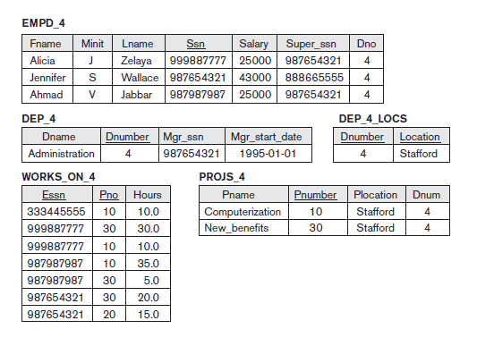
Data at Site 3

Slide 24
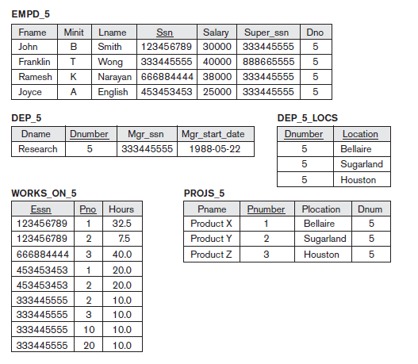
Data at Site 2

Slide 25
Query Processing in Distributed Databases
A distributed database query is processed in stages as follows:
Query Mapping The input query on distributed data is specified formally using a query language. It is then translated into an algebraic query on global relations. This translation is done by referring to the global conceptual schema and does not take into account the actual distribution and replication of data.
Localization In a distributed database, fragmentation results in relations being stored in separate sites, with some fragments possibly being replicated. This stage maps the distributed query on the global schema to separate queries on individual fragments using data distribution and replication information.

Slide 26
Contd..
Global Query Optimization. Optimization consists of selecting a strategy from a list of candidates that is closest to optimal. The total cost is a weighted combination of costs such as CPU cost, I/O costs, and communication costs. Since DDBs are connected by a network, often the communication costs over the network are the most significant.
Local Query Optimization. This stage is common to all sites in the DDB. The techniques are similar to those used in centralized systems.

Slide 27
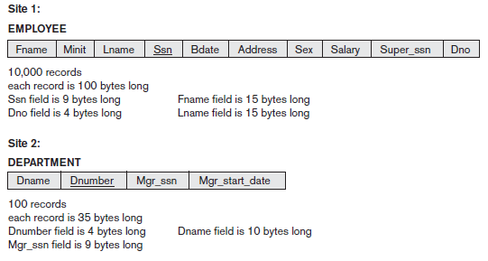
Data Transfer cost in Distributed Query Processing
Suppose that the EMPLOYEE and DEPARTMENT relations are distributed at two sites as follows

Slide 28
Contd..
Consider the query Q:
For each employee, retrieve the employee name and the name of the department for which the employee works. This can be stated as follows in the relational algebra:
The result of this query will include 10,000 records, assuming that every employee is related to a department. Each record in the query result is 40 bytes long.
The query is submitted at a distinct site 3, Neither the EMPLOYEE nor the DEPARTMENT relations reside at site 3.

Slide 29
Contd..
Transfer both the EMPLOYEE and the DEPARTMENT relations to the result site, and perform the join at site 3. In this case, a total of 1,000,000 + 3,500 = 1,003,500 bytes must be transferred.
Transfer the EMPLOYEE relation to site 2, execute the join at site 2, and send the result to site 3. The size of the query result is 40 * 10,000 = 400,000 bytes, so 400,000 + 1,000,000 = 1,400,000 bytes must be transferred.
Transfer the DEPARTMENT relation to site 1, execute the join at site 1, and send the result to site 3. In this case, 400,000 + 3,500 = 403,500 bytes must be transferred.

Slide 30
Contd..
Consider another query Q’: For each department, retrieve the department name and the name of the department manager. This can be stated as follows in the relational algebra:
Again, suppose that the query is submitted at site 3. the result of Q includes only 100 records, assuming that each department has a manager.

Slide 31
Contd..
Transfer both the EMPLOYEE and the DEPARTMENT relations to the result site, and perform the join at site 3. In this case, a total of 1,000,000 + 3,500 = 1,003,500 bytes must be transferred.
Transfer the EMPLOYEE relation to site 2, execute the join at site 2, and send the result to site 3. The size of the query result is 40 * 100 = 4,000 bytes, so 4,000 + 1,000,000 = 1,004,000 bytes must be transferred.
Transfer the DEPARTMENT relation to site 1, execute the join at site 1, and send the result to site 3. In this case, 4,000 + 3,500 = 7,500 bytes must be transferred.

Slide 32
Contd..
However, suppose that the result site is site 2; then we have two simple strategies:
1. Transfer the EMPLOYEE relation to site 2, execute the query, and present the result to the user at site 2. Here, the same number of bytes—1,000,000—must be transferred for both Q and Q’.
2. Transfer the DEPARTMENT relation to site 1, execute the query at site 1, and send the result back to site 2. In this case 400,000 + 3,500 = 403,500 bytes must be transferred for Q and 4,000 + 3,500 = 7,500 bytes for Q’.

Slide 33
Distributed Query Processing using Semi join
The idea behind distributed query processing using the semi join operation is to reduce the number of tuples in a relation before transferring it to another site.
Intuitively, the idea is to send the joining column of one relation R to the site where the other relation S is located; this column is then joined with S.
Following that, the join attributes, along with the attributes required in the result, are projected out and shipped back to the original site and joined with R. Hence, only the joining column of R is transferred in one direction, and a subset of S with no extraneous tuples or attributes is transferred in the other direction.

Slide 34
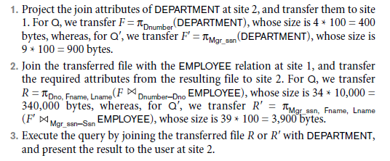
Contd..

Slide 35
Transaction Management in Distributed databases
The global and local transaction management software modules, along with the concurrency control and recovery manager of a DDBMS, collectively guarantee the ACID properties of transactions.
The global transaction manager is introduced for supporting distributed transactions. The site where the transaction originated can temporarily assume the role of global transaction manager and coordinate the execution of database operations with transaction managers across multiple sites.

Slide 36
Two Phase Commit Protocol
Phase 1.
When all participating databases signal the coordinator that the part of the multi database transaction involving each has concluded, the coordinator sends a message prepare for commit to each participant to get ready for committing the transaction.
Each participating database receiving that message will force-write all log records and needed information for local recovery to disk and then send a ready to commit or OK signal to the coordinator.
If the force-writing to disk fails or the local transaction cannot commit for some reason, the participating database sends a cannot commit or not OK signal to the coordinator.
If the coordinator does not receive a reply from the database within a certain time out interval, it assumes a not OK response.

Slide 37
Contd..
Phase 2.
If all participating databases reply OK, and the coordinator’s vote is also OK, the transaction is successful, and the coordinator sends a commit signal for the transaction to the participating databases.
Each participating database completes transaction commit by writing a [commit] entry for the transaction in the log and permanently updating the database if needed.
On the other hand, if one or more of the participating databases or the coordinator have a not OK response, the transaction has failed, and the coordinator sends a message to roll back or UNDO the local effect of the transaction to each participating database.

